Slide 1
Summary for the Sales interactive dashboard

Slide 2
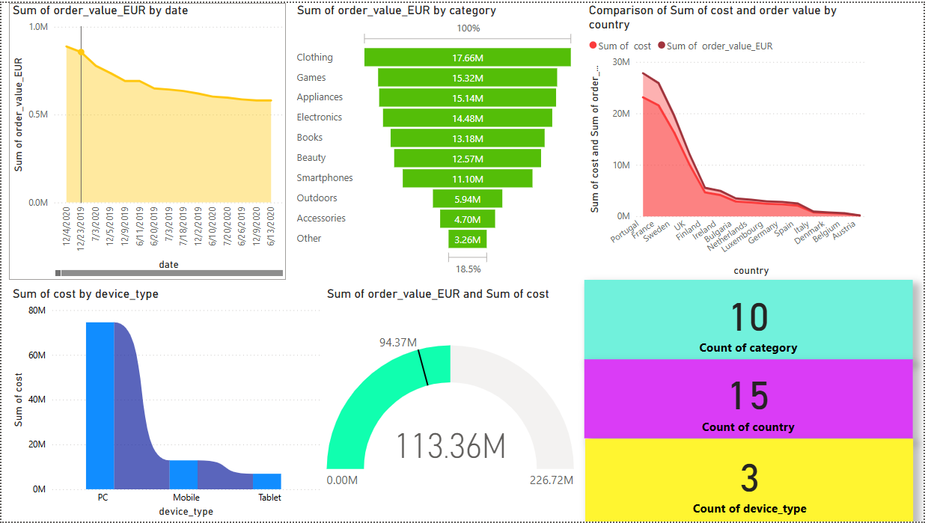

Slide 3
Conclusions from above charts.
At 8,87,734.89, 12/4/2020 had the highest Sum of order_value_EUR and was 5,113.33% higher than 2/7/2020, which had the lowest Sum of order_value_EUR at 17,028.19.﻿
Across all 536 date, Sum of order_value_EUR ranged from 17,028.19 to 8,87,734.89.﻿
﻿At 2,31,26,254.27, Portugal had the highest Sum of cost and was 14,873.49% higher than Austria, which had the lowest Sum of cost at 1,54,447.97.
﻿Sum of cost and total Sum of order_value_EUR are positively correlated with each other.
﻿Portugal accounted for 24.51% of Sum of cost .
﻿Sum of order_value_EUR and Sum of cost diverged the most when the country was Portugal, when Sum of order_value_EUR were 46,70,107.56 higher than Sum of cost.
﻿﻿Across all 536 date, Sum of order_value_EUR ranged from 17,028.19 to 8,87,734.89.﻿﻿ ﻿
﻿At 2,31,26,254.27, Portugal had the highest Sum of cost and was 14,873.49% higher than Austria, which had the lowest Sum of cost at 1,54,447.97.
﻿Sum of cost and total Sum of order_value_EUR are positively correlated with each other.
Portugal accounted for 24.51% of Sum of cost .

Slide 4
﻿Sum of order_value_EUR and Sum of cost diverged the most when the country was Portugal, when Sum of order_value_EUR were 46,70,107.56 higher than Sum of cost.
﻿PC had the highest Sum of cost at 7,45,58,985.55, followed by Mobile at 1,28,94,680.06 and Tablet at 69,15,645.38.
﻿ ﻿﻿Mobile had 1,28,94,680.06 Sum of cost , PC had 7,45,58,985.55, and Tablet had 69,15,645.38.﻿
﻿At 11,33,61,738.71, Sum of order_value_EUR has exceeded the target goal of 9,43,69,310.99.﻿
﻿At 11,33,61,738.71, Sum of order_value_EUR has exceeded the target goal of 9,43,69,310.99.
﻿At 11,33,61,738.71, Sum of order_value_EUR has exceeded the target goal of 9,43,69,310.99.﻿
﻿At 11,33,61,738.71, Sum of order_value_EUR has exceeded the target goal of 9,43,69,310.99.﻿

